Slide 1

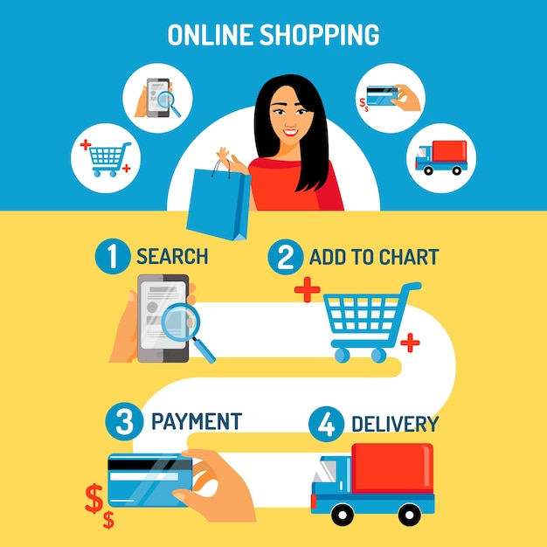
Online Shopping System [DAB 304 – 006]
Group: 11
Richa Patel
Dharmikkumar Patel
Surbhi Patel
Christin Jibu

Slide 2
Content:
Introduction of System
Business Objectives
Solution and Cost Estimation
WBS Chart
Cost & Budgets
Earned value Analysis
Outcomes

Slide 3

Introduction
“Online Shopping system” is a webpage mainly design for customers for the delivery of item/Products.
Our system provides business platform for all type of merchandise sale of products to elaborate the company by decreasing the cost.
The system provides the search menu for the customers to look after the perfect product to which they are looking for.
Customer can login / register to the system.
Customers can select the multiple item and add them into the cart.
There is multiple payment options available for the customers, like UPI, Credit card, Debit Card payment system.
If the product is unappropriated, they can return the order from the doorstep according to the return policy within particular time. Refund can be generated after the quality check of the return product, it can be refund directly to the bank account or else to the wallet card.

Slide 4
Features
Customer can easily filter the product commonly by size, color, material of the cloths.
A features than excepts all types of payments that customers can easily pay
A feature that allows customers to return the item from the doorsteps.

Slide 5
Project Objectives
To create an online shopping system, which has many features such as ability to search for the particular item like dresses, shoes, bag, etc. and add them to the cart for further process towards ordering it.
Further the searched item is being filtered by its different features. Like dresses are filter by color, size, material; whereas bag can be filtered by its style, color, material, etc. To sort the items the feature sort is used to sort by price ie. Highest price to lowest, lower price to higher, increasing order A-Z.
For delivering the product to the doorstep, customer need to add their home address with the phone number. Additionally, they can also add the office address with the timing to receive the product to their different address.
Customers can pay their bills through credit card, debit card, API and they will receive the payment message directly from the system.
The feature of return policy is there to return the product within the time, need not to visit the store, as it gets collected from the doorstep, and payment gets refund directly to the bank or wallet.

Slide 6
Baseline of the evalution
These were the project objectives that were defined beforehand –
1.Total Project Budget – 219182.
2. Project Estimated Completion Time – 233.
3. Total Project Tasks – 4, Subtasks – 18 tasks4.
4. Based on requirements, Developers and Programmers were assigned to the project.
The project working and project status will be analyzed in the following slides based on current state and completion at 50%.
We followed the bottom-up method of cost estimating for this project, giving each activity a budget, and comparing it to real costs.
For this project, we performed earned value analysis to determine our cost variance, schedule variance, and project overview depending on the present status of the project.

Slide 7
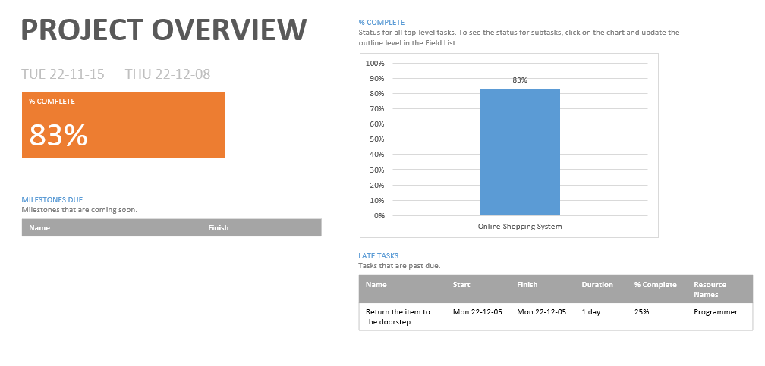
Project Overview
Based on the current status, project is 83% complete. Finish date of project is 8th December, but still it is not finished. After performing all the task, we have total 1 task and 4 subtask remaining that we need to finish by the end of finish day.Developer as well as programmer resources are assigned to each task.

Slide 8
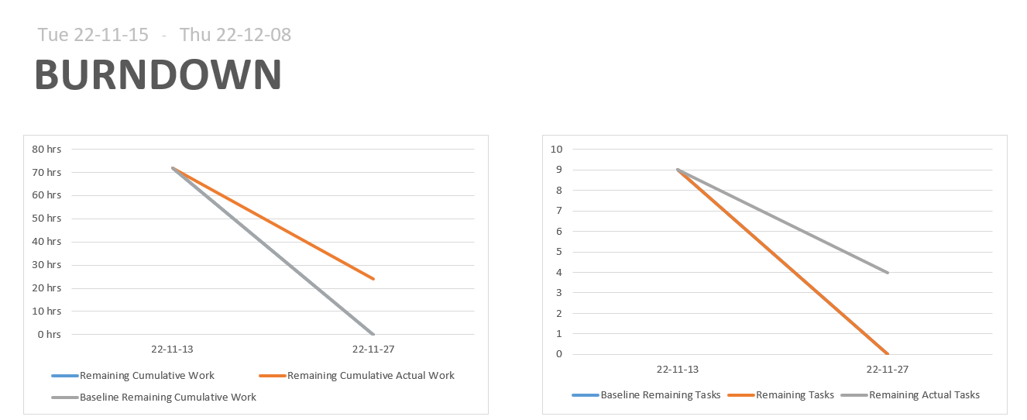
Burndown Chart
Above burndown chart is created from 15th November to 08th December. This chart shows how much work you have completed and how much you have left. So, we can say that we are behind the schedule. Around 10-25 hours of work still we need to complete and for completing the task we have left total 4 subtasks.

Slide 9
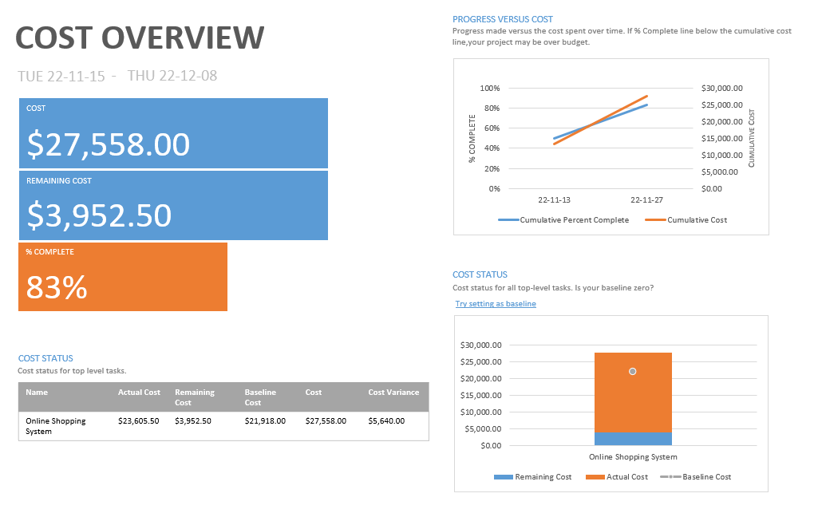
Cost Overview
From the cost overview report, our actual cost is 23,605.50, remaining cost is 3952.50, baseline cost is 21,918.00, and our cost value is 27,558.00.

Slide 10
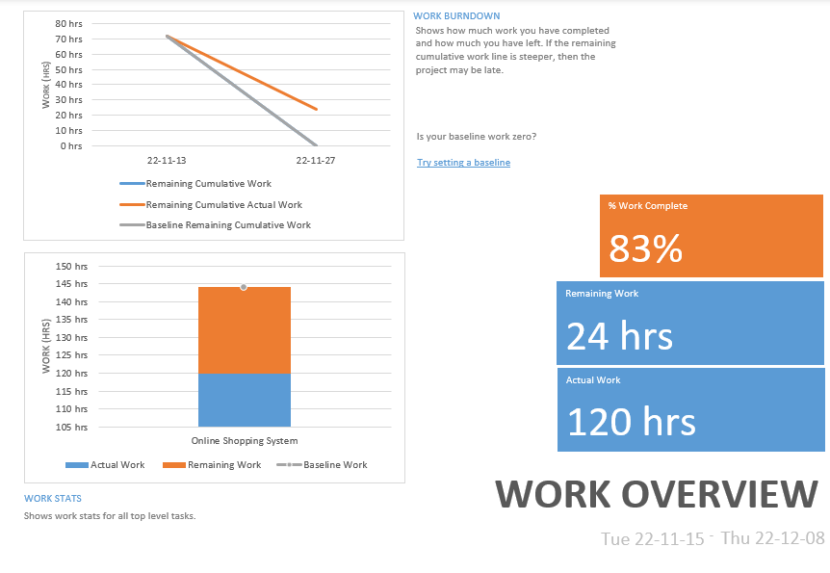
Work overview
Total 83% of work has been completed for our project.
Our actual work is 120 hrs and remaining work is 24 hrs as there are total 4 subtask remaining.

Slide 11
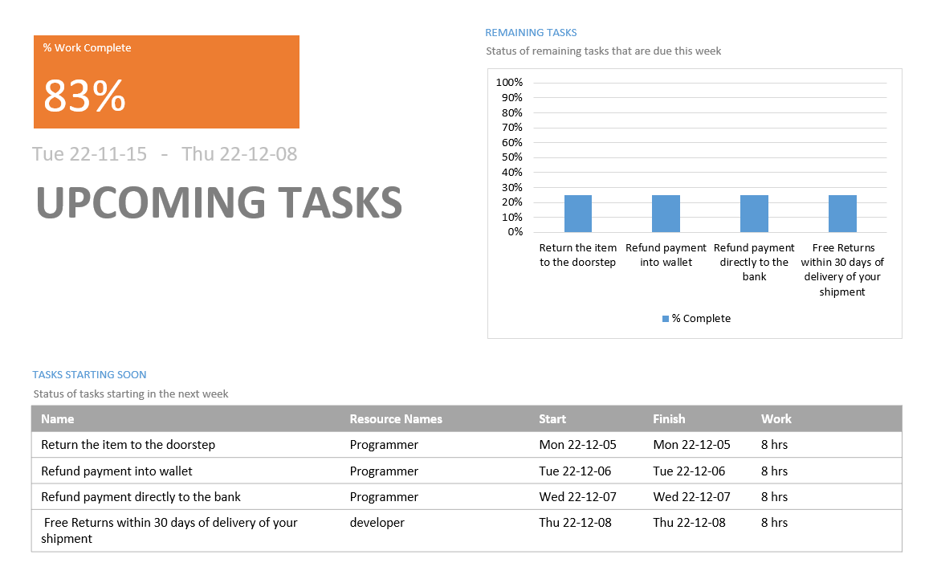
Upcoming task
From the WBS, there are total 4 task and 18 subtasks.
All three tasks have been 100% completed by the timelimit, but, last task and all subtasks have only 25% finished.
That is why our total work completion is 83% instead of 100%.

Slide 12
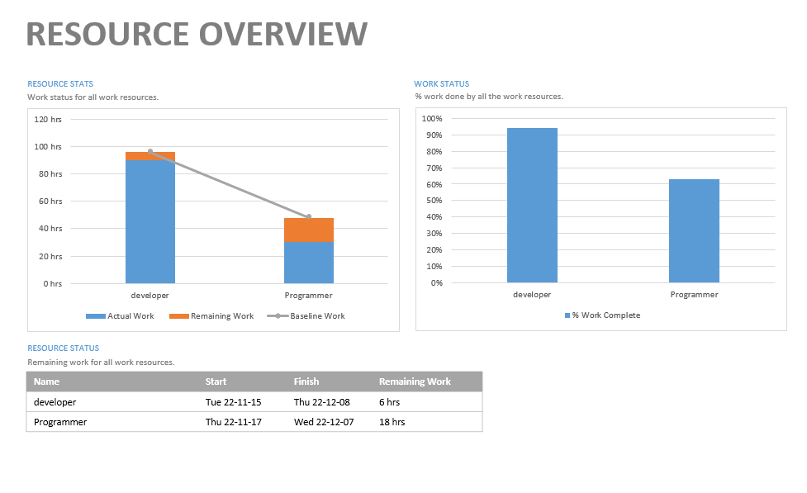
Resource overview
For this project, developers and programmers are the resources.
Developers have more task to complete as compared to programmers.
For the remaining work, developers need 6 hrs for completing the task, on the other hand programmer need 18 hrs for completing task.

Slide 13

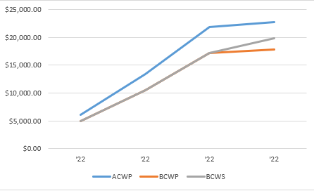
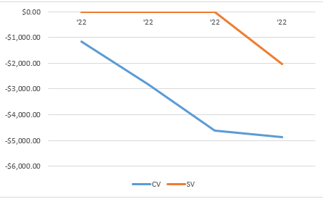
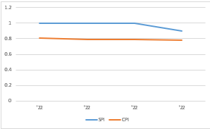
Earned Value Analysis

Slide 14
The performance of a project may be measured with the use of earned value management. To determine if the project is on track, costs and schedule are compared to a baseline.
Here, Actual cost(ACWP) is higher than earned value(BCWP), so we can say that our project is over budget.
Planned value(BCWS) is higher than the earned value, so we can say that our project is behind schedule.
From the above graph, the value of CV is negative, so our project is over budget.

Slide 15

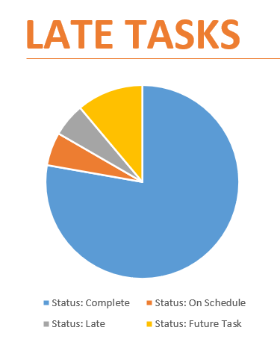
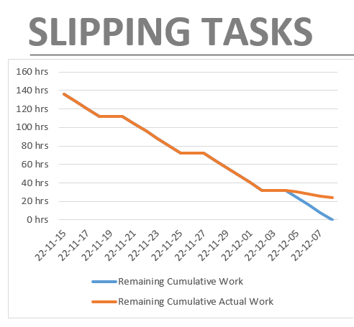
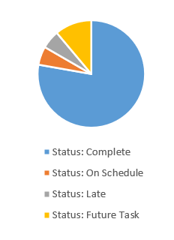
In progress Task

Slide 16
Outcomes
From the current status and analysis of the project, we can say that, speed should be improved to finish the task by the timeline.
Budget as well as more resources should be added.
More people should be hired to complete the project within a task.
More task should be added to get complete accuracy for our project.

Slide 17
Thank you

